Slide 1
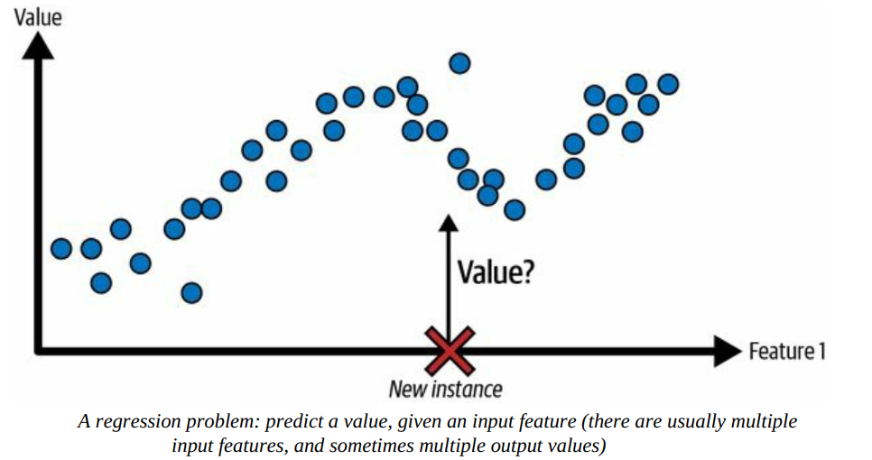
Supervised Learning: Regression
A typical task is to predict a target numeric value, such as the price of a car, given a set of features (mileage, age, brand, etc.). This sort of task is called regression.⁠

Slide 2
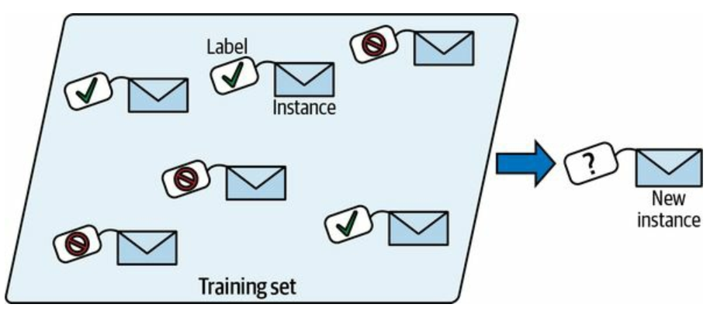
Supervised Learning
Another typical supervised learning task is classification. The spam filter is a good example of this: it is trained with many example emails along with their class (spam or ham), and it must learn how to classify new emails.

Slide 3
Regression
Simple Linear Regression
Multiple Linear Regression
Polynomial Linear Regression
Logistic Regression

Slide 4
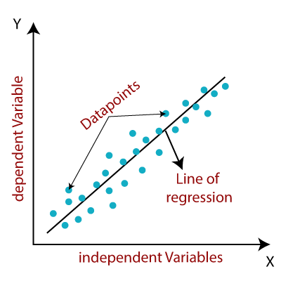
Linear Regression
Linear regression is a supervised machine learning algorithm that models the linear relationship between a dependent variable and one or more independent variables by fitting a straight line to the observed data.
https://www.javatpoint.com/linear-regression-in-machine-learning

Slide 5
Linear Regression
Linear regression is a supervised machine learning algorithm that models the linear relationship between a dependent variable and one or more independent variables by fitting a straight line to the observed data.
When there is a single independent variable, it is referred to as Simple Linear Regression, whereas with multiple independent variables, it is called Multiple Linear Regression.
Polynomial Linear Regression is a form of regression where the relationship between the independent variable(s) and the dependent variable is modeled as a polynomial, but it is still considered a type of linear regression because the model is linear in terms of the coefficients.

Slide 6
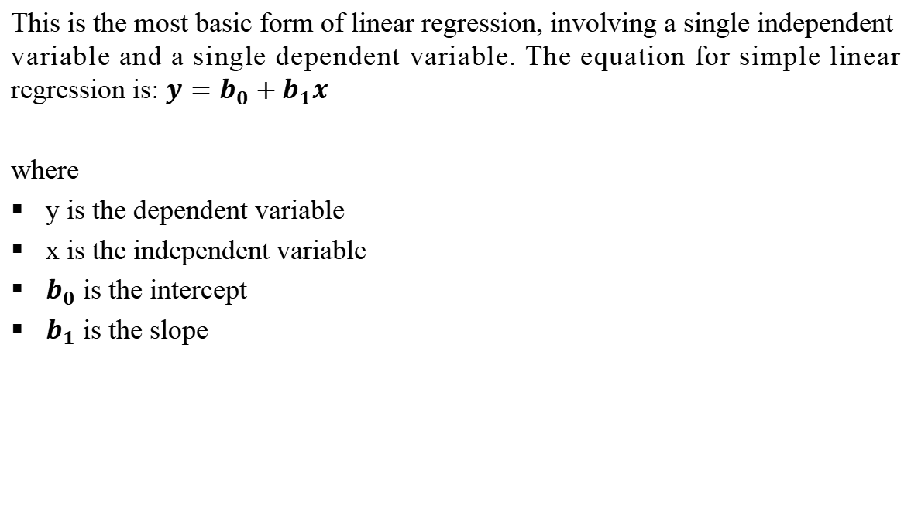
Simple Linear Regression
This is the most basic form of linear regression, involving a single independent variable and a single dependent variable. The equation for simple linear regression is: $y=b_{0}+b_{1}x$
where
y is the dependent variable
x is the independent variable
$b_{0}$ is the intercept
$b_{1}$ is the slope

Slide 7
Example
Suppose we are analyzing the relationship between the number of hours a student studies (x) and their exam score (y) using a simple linear regression. After running the regression, we get the following equation: y=5x+50
In this equation:
𝑦is the predicted exam score,
𝑥is the number of hours studied,
The slope 𝑚 = 5
m=5 indicates that for each additional hour of studying, the exam score is expected to increase by 5 points.
The intercept 𝑏= 50
b=50 suggests that if a student studies 0 hours, the predicted exam score would be 50 points.

Slide 8
Example calculation using the slope:
If a student studies 4 hours (𝑥= 4 ),
the predicted score is: y=5(4)+50=20+50=70
Thus, according to this regression model, studying for an extra hour would raise a student’s expected exam score by 5 points.

Slide 9
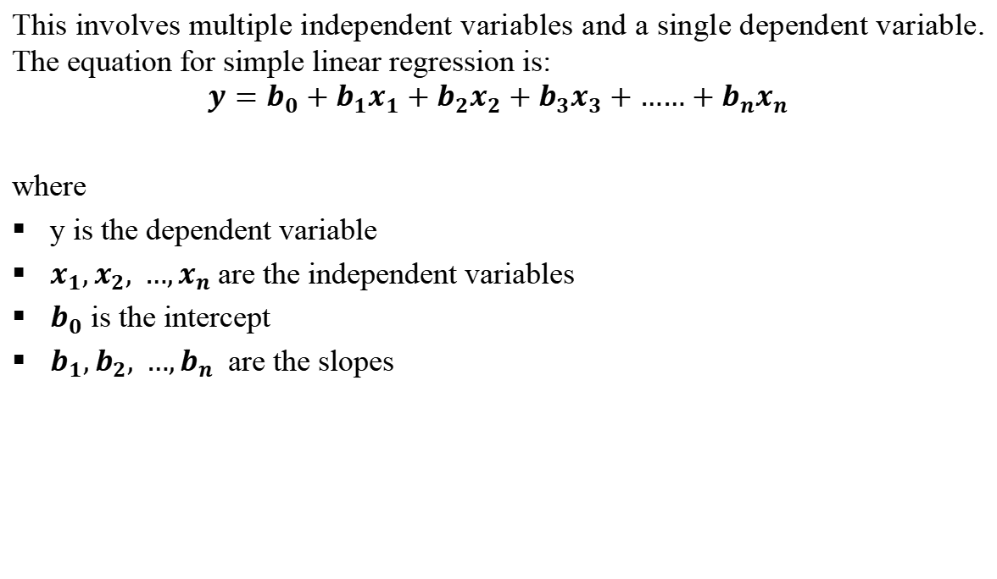
Multiple Linear Regression
This involves multiple independent variables and a single dependent variable. The equation for simple linear regression is:
$$y=b_{0}+b_{1}x_{1}+b_{2}x_{2}+b_{3}x_{3}+{……+b}_{n}x_{n}$$
where
y is the dependent variable
$x_{1},x_{2}, …,x_{n}$are the independent variables
$b_{0}$ is the intercept
$b_{1},b_{2}, …,b_{n}$ are the slopes

Slide 10
EXample
Scenario
Imagine we want to predict a person’s monthly salary (y) based on their years of education (x1) and years of work experience (x2). The multiple regression model would look like this:
y=b0+b1x1+b2x2
Where:
Y is the monthly salary (dependent variable),
X_{1​} is the number of years of education,
x₂ is the number of years of work experience,
b₀ is the intercept (baseline salary if x1 and x2 are zero),
b_{1​} and b₂ are the coefficients showing how much salary changes with each additional year of education and experience, respectively.

Slide 11
EXample
Example Model Output
Let’s say we use data to fit this model, and the result is:
y=2000+1500x₁+800x₂
Interpretation:
Intercept (2000): A baseline salary of $2,000 for someone with zero years of education and experience.
Coefficient for x₁ (1500): Each additional year of education increases the predicted salary by $1,500.
Coefficient for x₂ (800): Each additional year of work experience increases the predicted salary by $800.

Slide 12
EXample
Using the Model
If a person has 16 years of education and 5 years of work experience, we can predict their salary as follows:
y=2000+1500(16)+800(5)=2000+24000+4000=30,000
So, based on this model, their predicted monthly salary would be $30,000

Slide 13
Linear Regression
The objective of the algorithm is to determine the best-fit line equation that can predict values based on the independent variables.
In regression, a dataset with X and Y values is provided, and these values are used to train a function. Once trained, this function can be applied to predict Y for an unknown X.
In regression, the goal is to estimate the value of Y, meaning a function is needed that predicts the continuous Y value given X as the independent variable(s).

Slide 14
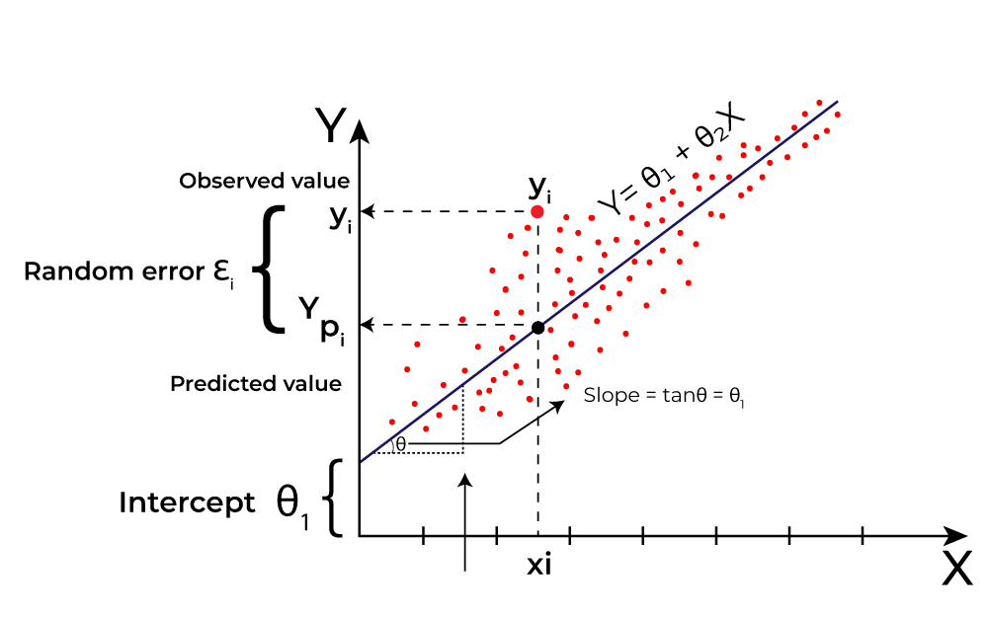
Linear Regression
What is the best Fit Line?
The main goal of using linear regression is to find the best-fit line, which minimizes the error between the predicted and actual values. The best-fit line will have the least amount of error.
The equation of the best-fit line represents the relationship between the dependent and independent variables, with the slope indicating how much the dependent variable changes in response to a unit change in the independent variable(s).
https://www.geeksforgeeks.org/ml-linear-regression/

Slide 15
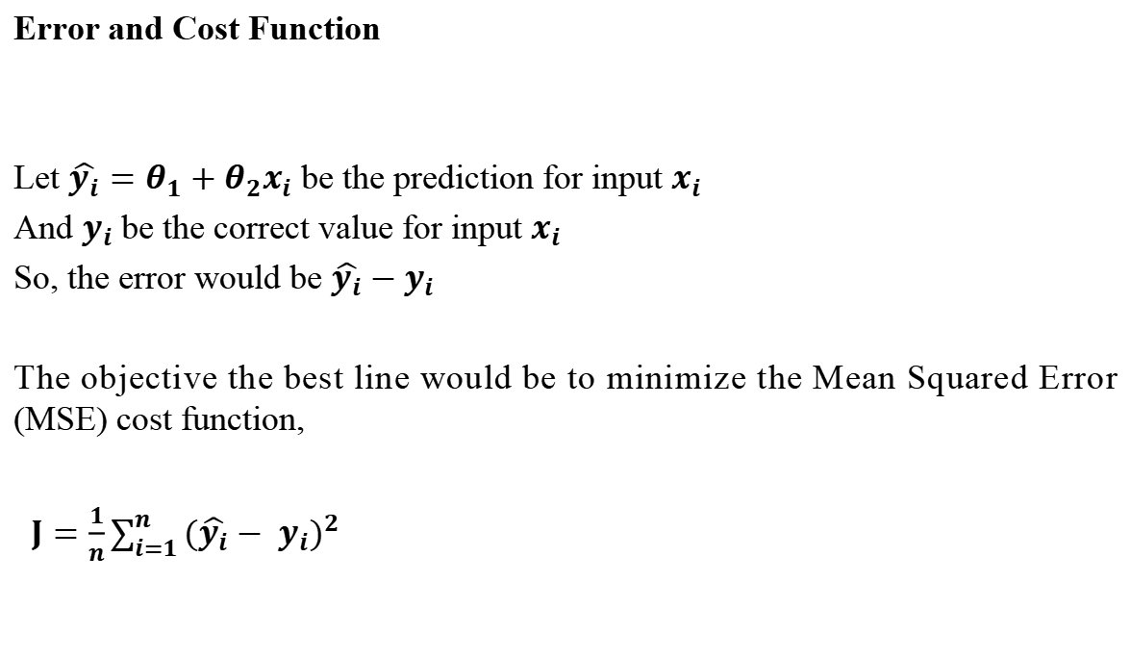
Linear Regression
Error and Cost Function
Let $\hat{y_{i}}=θ_{1}+θ_{2}x_{i}$ be the prediction for input $x_{i}$
And $y_{i}$be the correct value for input $x_{i}$
So, the error would be $\hat{y_{i}}−$ $y_{i}$
The objective the best line would be to minimize the Mean Squared Error (MSE) cost function,
$J=\frac{1}{n}\sum_{i=1}^{n}{{(\hat{y_{i}}− y_{i})}^{2}}$

Slide 16
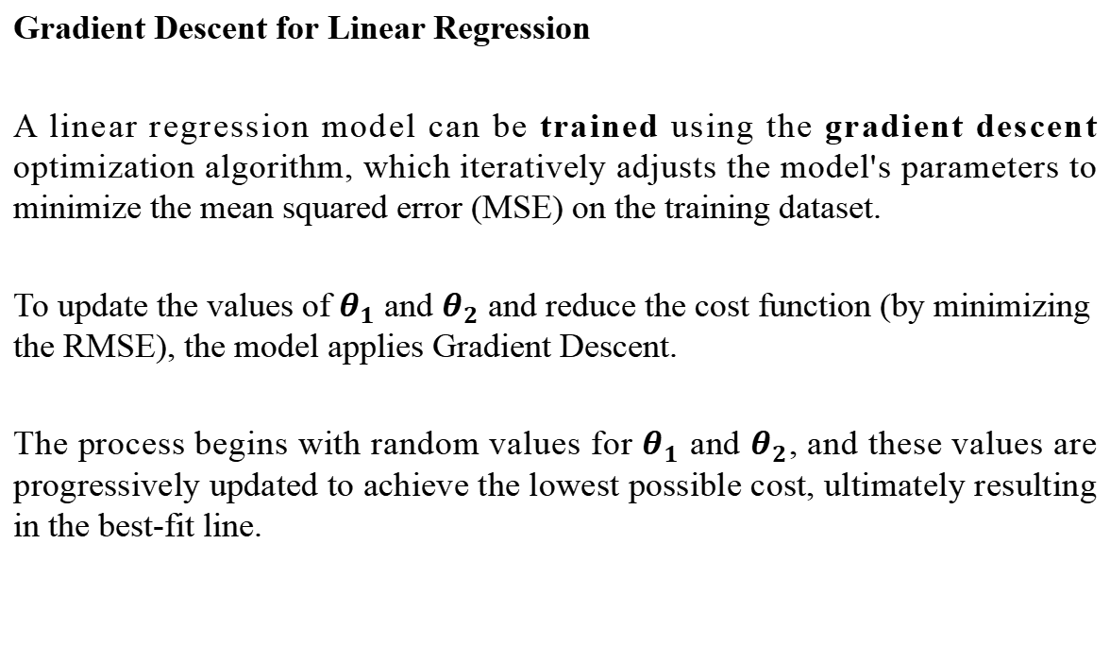
Linear Regression
Gradient Descent for Linear Regression
A linear regression model can be trained using the gradient descent optimization algorithm, which iteratively adjusts the model's parameters to minimize the mean squared error (MSE) on the training dataset.
To update the values of $θ_{1}$ and $θ_{2}$ and reduce the cost function (by minimizing the RMSE), the model applies Gradient Descent.
The process begins with random values for $θ_{1}$ and $θ_{2}$, and these values are progressively updated to achieve the lowest possible cost, ultimately resulting in the best-fit line.

Slide 17
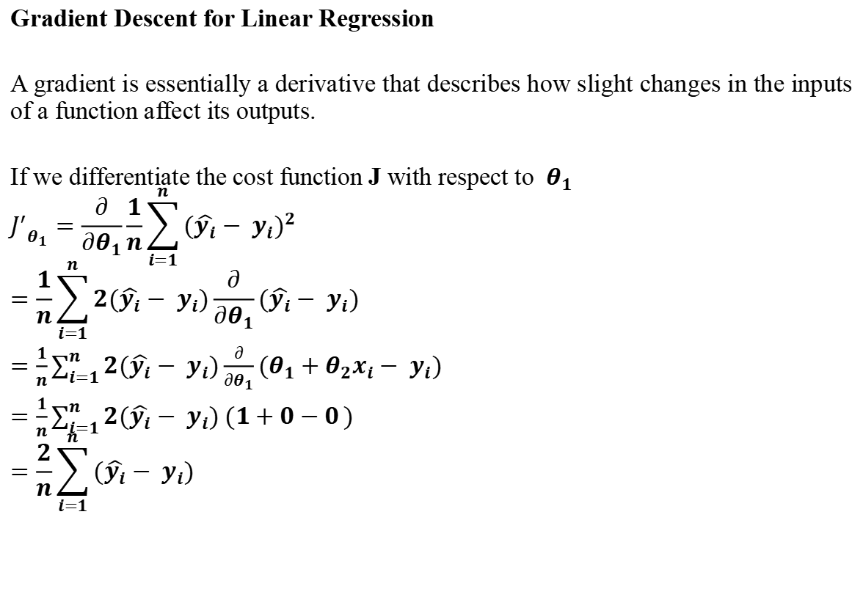
Linear Regression
Gradient Descent for Linear Regression
A gradient is essentially a derivative that describes how slight changes in the inputs of a function affect its outputs.
If we differentiate the cost function J with respect to ​ $θ_{1}$
$${J^{′}}_{θ_{1}}=\frac{∂}{∂θ_{1}}\frac{1}{n}\sum_{i=1}^{n}{{(\hat{y_{i}}− y_{i})}^{2}}$$
$$=\frac{1}{n}\sum_{i=1}^{n}{2(\hat{y_{i}}− y_{i})}\frac{∂}{∂θ_{1}}(\hat{y_{i}}− y_{i})$$
$=\frac{1}{n}\sum_{i=1}^{n}{{2(\hat{y_{i}}− y_{i})\frac{∂}{∂θ_{1}}(θ}_{1}+θ_{2}x_{i}− y_{i})}$
$=\frac{1}{n}\sum_{i=1}^{n}{2(\hat{y_{i}}− y_{i}) (1+0−0})$
$$=\frac{2}{n}\sum_{i=1}^{n}{(\hat{y_{i}}− y_{i})}$$

Slide 18
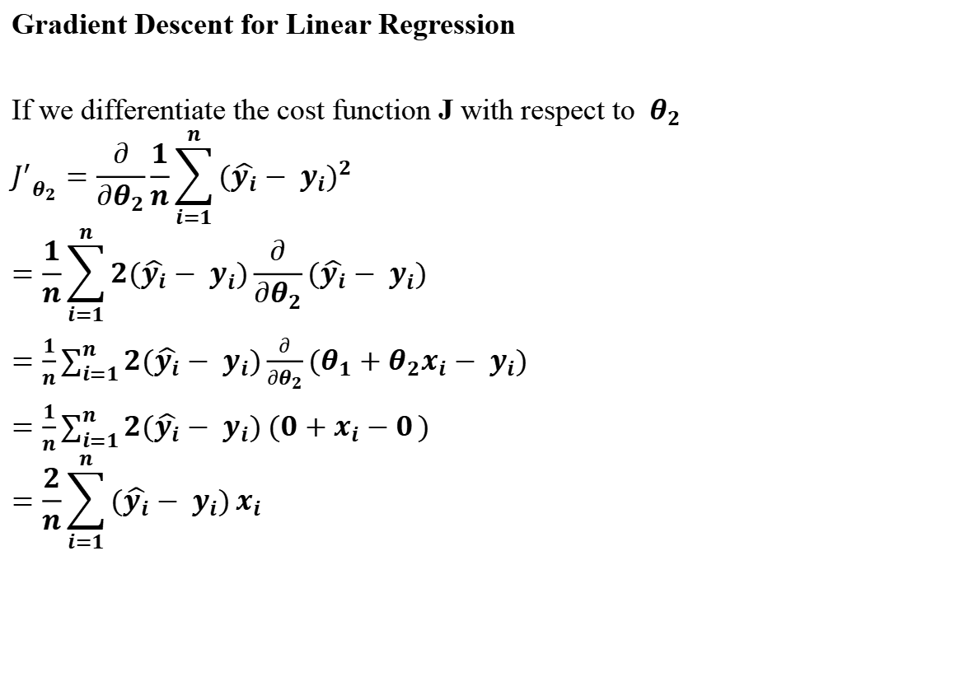
Linear Regression
Gradient Descent for Linear Regression
If we differentiate the cost function J with respect to ​ $θ_{2}$
$${J^{′}}_{θ_{2}}=\frac{∂}{∂θ_{2}}\frac{1}{n}\sum_{i=1}^{n}{{(\hat{y_{i}}− y_{i})}^{2}}$$
$$=\frac{1}{n}\sum_{i=1}^{n}{2(\hat{y_{i}}− y_{i})}\frac{∂}{∂θ_{2}}(\hat{y_{i}}− y_{i})$$
$=\frac{1}{n}\sum_{i=1}^{n}{{2(\hat{y_{i}}− y_{i})\frac{∂}{∂θ_{2}}(θ}_{1}+θ_{2}x_{i}− y_{i})}$
$=\frac{1}{n}\sum_{i=1}^{n}{2(\hat{y_{i}}− y_{i}) (0+x_{i}−0})$
$$=\frac{2}{n}\sum_{i=1}^{n}{(\hat{y_{i}}− y_{i})}x_{i}$$

Slide 19
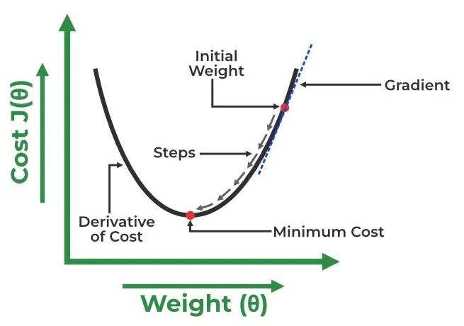
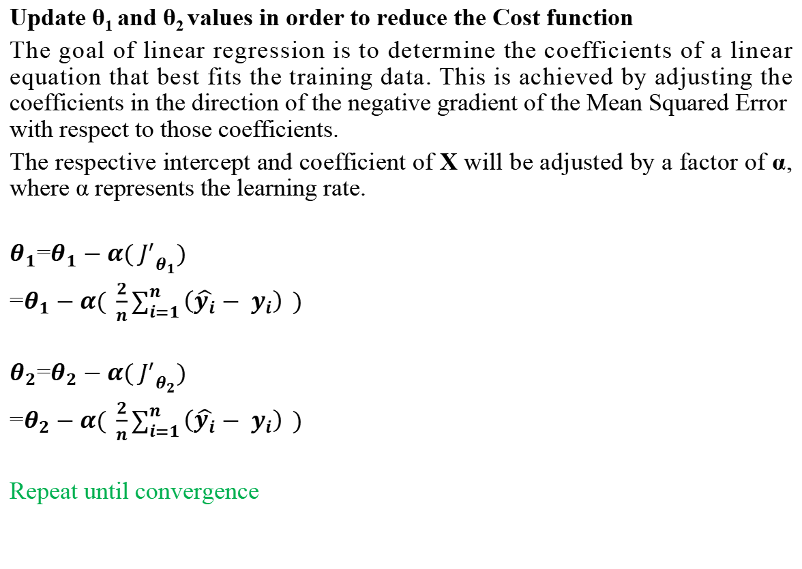
Linear Regression
Update θ₁ and θ₂ values in order to reduce the Cost function
The goal of linear regression is to determine the coefficients of a linear equation that best fits the training data. This is achieved by adjusting the coefficients in the direction of the negative gradient of the Mean Squared Error with respect to those coefficients.
The respective intercept and coefficient of X will be adjusted by a factor of α, where α represents the learning rate.
$θ_{1}$=$θ_{1}−α( {J^{′}}_{θ_{1}})$
=$θ_{1}−α( \frac{2}{n}\sum_{i=1}^{n}{\left(\hat{y_{i}}− y_{i}\right)} )$
$θ_{2}$=$θ_{2}−α( {J^{′}}_{θ_{2}})$
=$θ_{2}−α( \frac{2}{n}\sum_{i=1}^{n}{\left(\hat{y_{i}}− y_{i}\right)} )$
Repeat until convergence
https://www.geeksforgeeks.org/ml-linear-regression/

Slide 20
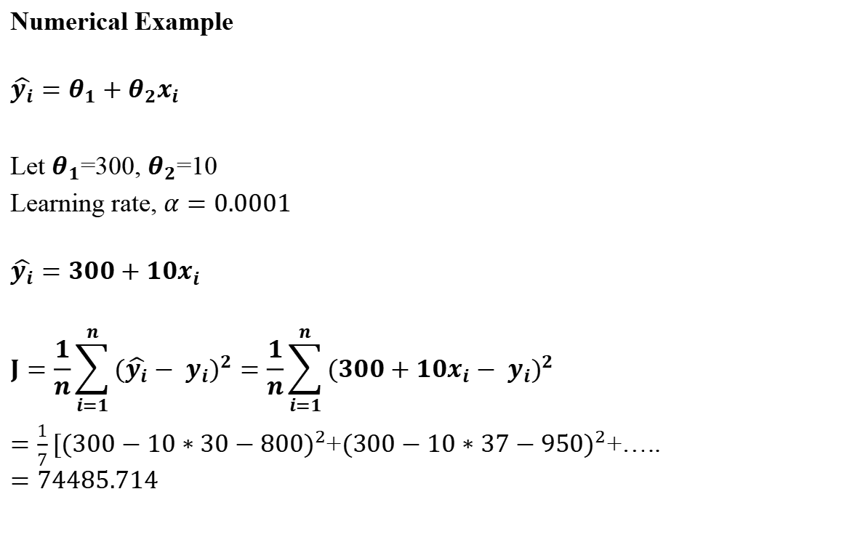
Linear Regression
Age (x) | Salary (y)
30 | 800
37 | 950
25 | 600
43 | 1050
50 | 1200
29 | 740
46 | 1100
Numerical Example
$$\hat{y_{i}}=θ_{1}+θ_{2}x_{i}$$
Let $θ_{1}$=300, $θ_{2}$=10
Learning rate, $α=0.0001$
$$\hat{y_{i}}=300+10x_{i}$$
$$J=\frac{1}{n}\sum_{i=1}^{n}{{(\hat{y_{i}}− y_{i})}^{2}}=\frac{1}{n}\sum_{i=1}^{n}{{(300+10x_{i}− y_{i})}^{2}}$$
$=\frac{1}{7}[{(300−10∗30−800)}^{2}$+${(300−10∗37−950)}^{2}$+…..
$$=74485.714$$

Slide 21
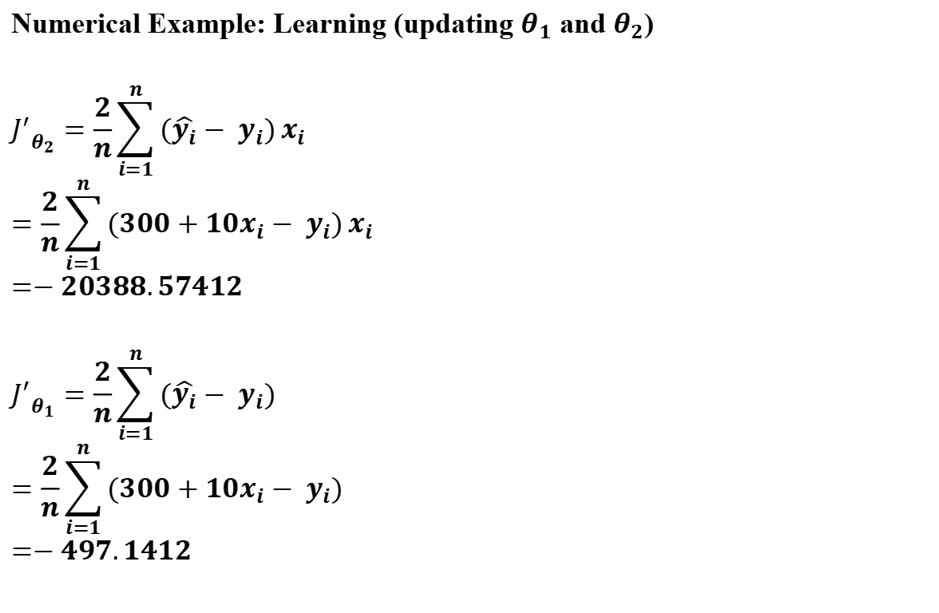
Linear Regression
Age (x) | Salary (y)
30 | 800
37 | 950
25 | 600
43 | 1050
50 | 1200
29 | 740
46 | 1100
Numerical Example: Learning (updating $θ_{1}$ and $θ_{2}$)
$${J^{′}}_{θ_{2}}=\frac{2}{n}\sum_{i=1}^{n}{(\hat{y_{i}}− y_{i})}x_{i}$$
$$=\frac{2}{n}\sum_{i=1}^{n}{(300+10x_{i}− y_{i})}x_{i}$$
$$=−20388.57412$$
$${J^{′}}_{θ_{1}}=\frac{2}{n}\sum_{i=1}^{n}{(\hat{y_{i}}− y_{i})}$$
$$=\frac{2}{n}\sum_{i=1}^{n}{(300+10x_{i}− y_{i})}$$
$$=−497.1412$$

Slide 22
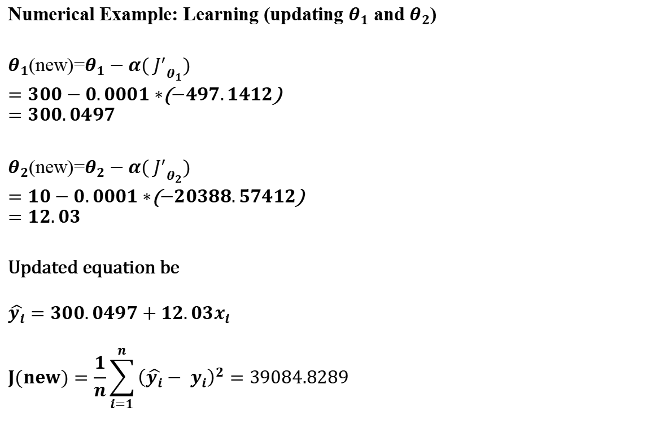
Linear Regression
Age (x) | Salary (y)
30 | 800
37 | 950
25 | 600
43 | 1050
50 | 1200
29 | 740
46 | 1100
Numerical Example: Learning (updating $θ_{1}$ and $θ_{2}$)
$θ_{1}$(new)=$θ_{1}−α( {J^{′}}_{θ_{1}})$
$=300−0.0001∗$($−497.1412$)
$$=300.0497$$
$θ_{2}$(new)=$θ_{2}−α( {J^{′}}_{θ_{2}})$
$=10−0.0001∗$($−20388.57412$)
$$=12.03$$
Updated equation be
$$\hat{y_{i}}=300.0497+12.03x_{i}$$
$$J(new)=\frac{1}{n}\sum_{i=1}^{n}{{\left(\hat{y_{i}}− y_{i}\right)}^{2}}=39084.8289$$
Repeat until convergence

Slide 23
Linear Regression
Example with code
Python Notebook
https://colab.research.google.com/drive/1Q0XGUHv5tpbl5IixjuJAEGQIPhNDaIjc?usp=sharing

Slide 24
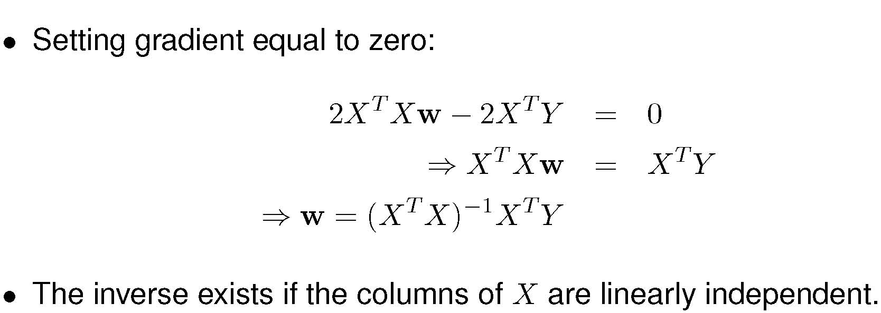
Some Linear Algebra - The Solution!
Notes:
1. The process in the previous slide can be performed as a matrix operation at once.

Slide 25
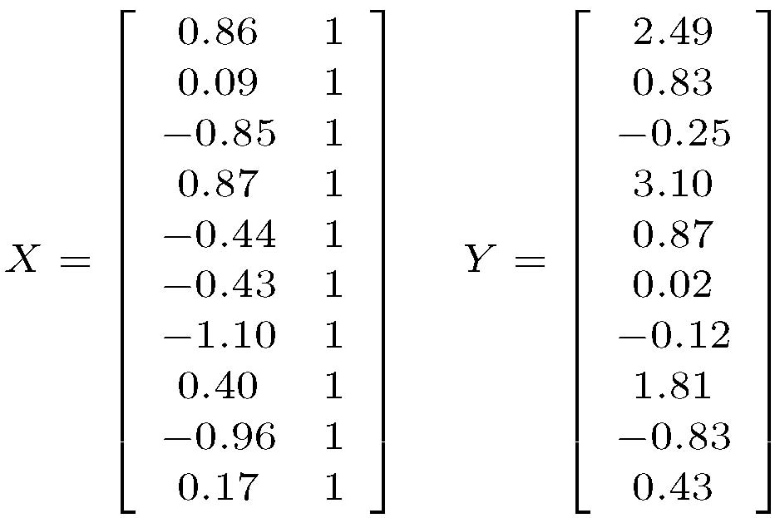
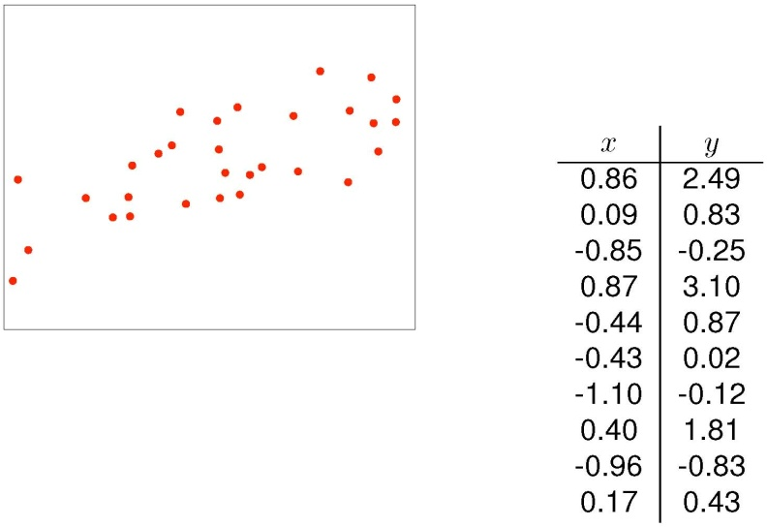
Example of Linear Regression - Data Matrices
Notes:
1. The process in the previous slide can be performed as a matrix operation at once.

Slide 26
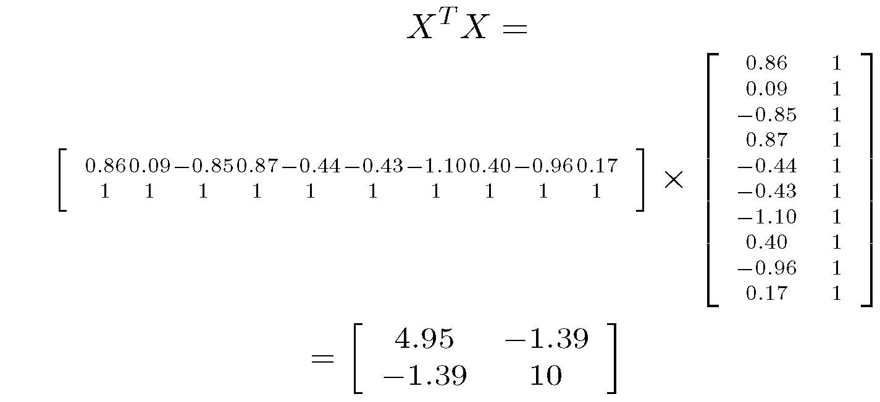
X^{T}X
Notes:
1. The process in the previous slide can be performed as a matrix operation at once.

Slide 27
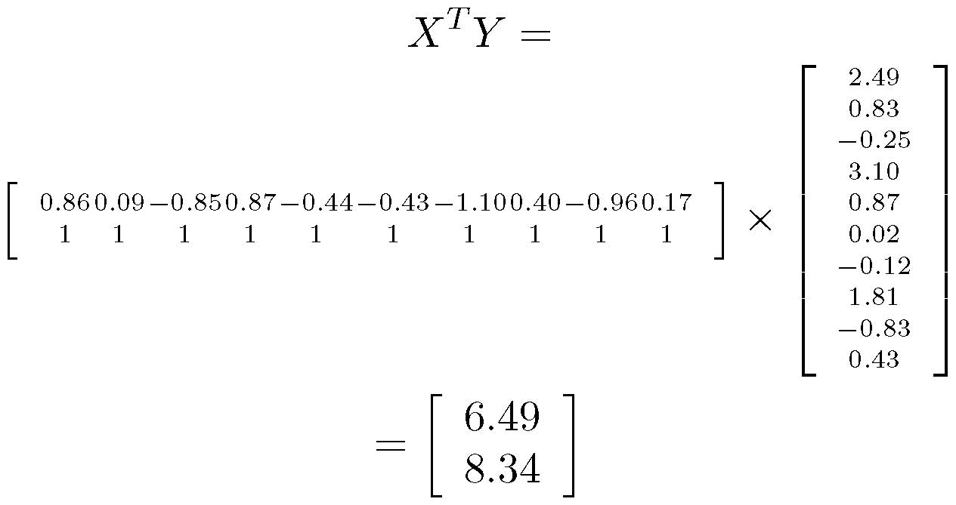
X^{T}Y
Notes:
1. The process in the previous slide can be performed as a matrix operation at once.

Slide 28
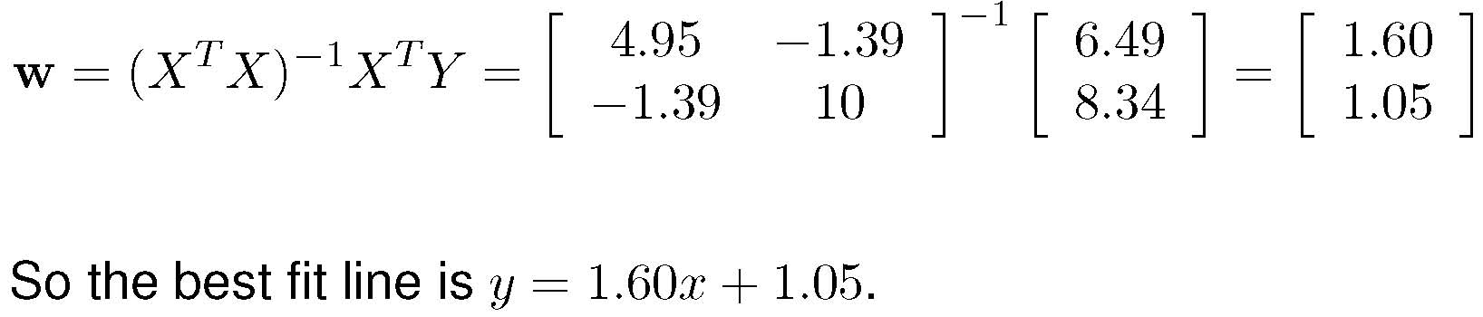
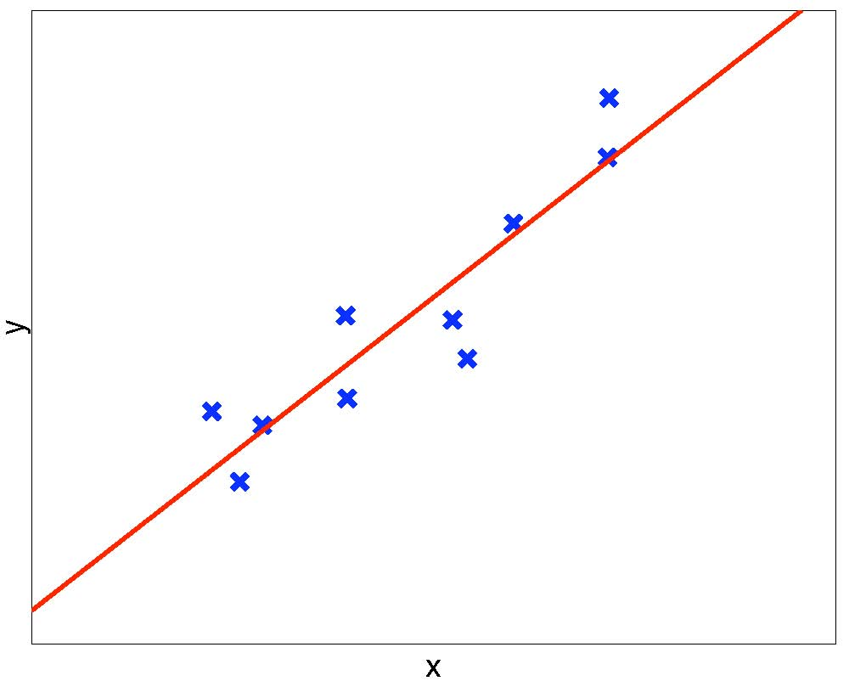
Solving for w – Regression Curve
Notes:
1. The process in the previous slide can be performed as a matrix operation at once.

Slide 29
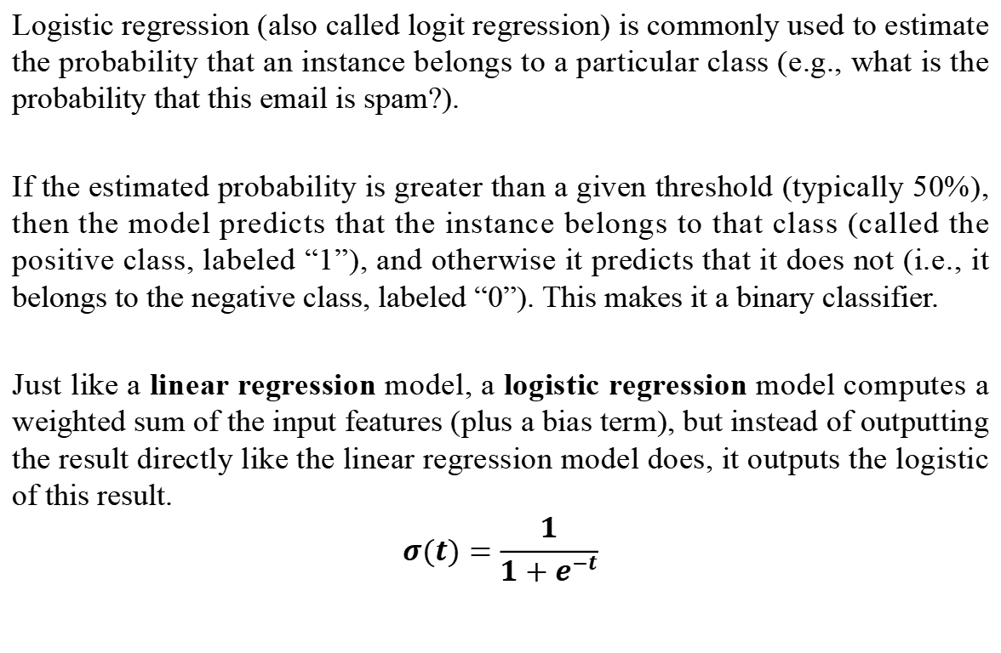
Logistic Regression
Logistic regression (also called logit regression) is commonly used to estimate the probability that an instance belongs to a particular class (e.g., what is the probability that this email is spam?).
If the estimated probability is greater than a given threshold (typically 50%), then the model predicts that the instance belongs to that class (called the positive class, labeled “1”), and otherwise it predicts that it does not (i.e., it belongs to the negative class, labeled “0”). This makes it a binary classifier.
Just like a linear regression model, a logistic regression model computes a weighted sum of the input features (plus a bias term), but instead of outputting the result directly like the linear regression model does, it outputs the logistic of this result.
$$σ(t)=\frac{1}{1+e^{−t}}$$

Slide 30
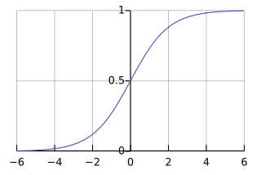
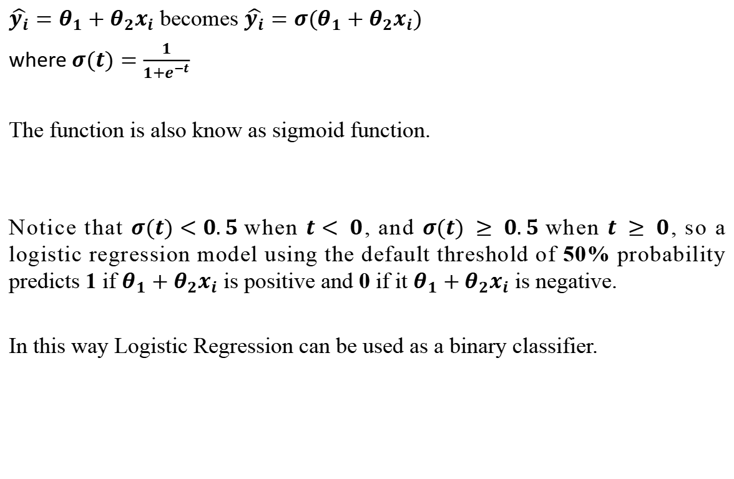
Logistic Regression
$\hat{y_{i}}=θ_{1}+θ_{2}x_{i}$ becomes $\hat{y_{i}}={σ(θ}_{1}+θ_{2}x_{i})$
where $σ(t)=\frac{1}{1+e^{−t}}$
The function is also know as sigmoid function.
Notice that $σ(t)<0.5$when $t< 0$, and $σ(t) ≥ 0.5$when $t ≥ 0$, so a logistic regression model using the default threshold of 50% probability predicts 1 if $θ_{1}+θ_{2}x_{i}$ is positive and 0 if it $θ_{1}+θ_{2}x_{i}$ is negative.
In this way Logistic Regression can be used as a binary classifier.
https://en.wikipedia.org/wiki/Sigmoid_function

